Slide 1
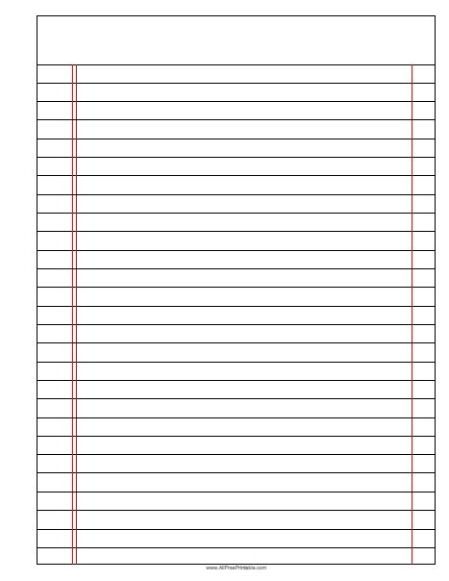






The Effect of Pollution on Biodiversity
Read Now
Sunday 18 January 2026
The Effect of Pollution on Biodiversity
Task:
Complete the Read Now by:
Stick in the sheet.
Using a highlighter as you read to identify key terms.
Answer the first four recall questions under the sheet in your book.
Answer the stretch question
The Effect of Pollution on Biodiversity
The Effect of Pollution on Biodiversity
Aim High | Work Together | Be Kind | Lead the Way

Slide 2
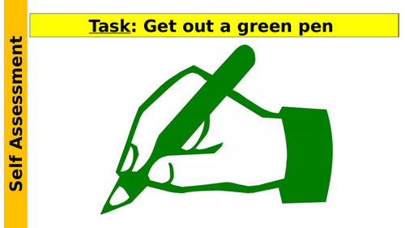
Read Now
Aim High | Work Together | Be Kind | Lead the Way
Aim High | Work Together | Be Kind | Lead the Way

Slide 3
Read Now
MARK SCHEME
1. Biodiversity means fewer types of living things. (line 1)
2. Pollution affects ecosystems by harming plants and animals. (lines 6-7)
3. One example is plastic in oceans harming fish. (line 5)
4. Healthy ecosystems provide clean air and water. (line 8)
5. A growing human population increases pollution by creating more waste. (line 3)
Aim High | Work Together | Be Kind | Lead the Way
Aim High | Work Together | Be Kind | Lead the Way

Slide 4
Daily Review
Follow your teachers instructions:
“When I say go show me a MWB and a MWB Pen”
You will have 10 seconds for each question.
Hold your MWB in the Ready position
“Show me”
You need to score 70% to pass
Subtitle ‘test score’ ?/10
Aim High | Work Together | Be Kind | Lead the Way
Notes:
Teachers remember to input the quiz score

Slide 5
Objectives
Following this lesson, students will be able to:
• Describe the effect of the increasing human population on the amount of waste produced
• Describe the different types of pollution
• Describe some consequences of pollution
Lesson 1
Lesson 2
Lesson 3
Lesson 4
Lesson 5
Lesson 6
Lesson 8
Lesson 9
Lesson 10
Lesson 7
Aim High | Work Together | Be Kind | Lead the Way
Notes:
11.2 5.19

Slide 6
Exposition
Aim High | Work Together | Be Kind | Lead the Way
Notes:
11.31 1.42
11.2 4.35

Slide 7
Exposition
Aim High | Work Together | Be Kind | Lead the Way
Notes:
11.31 1.42
11.2 4.35

Slide 8
Exposition
Aim High | Work Together | Be Kind | Lead the Way
Notes:
11.2 1.43
11.2 1.7

Slide 9
Deliberate Practice
Big Question:
Aim High | Work Together | Be Kind | Lead the Way

Slide 10

Deliberate Practice
Aim High | Work Together | Be Kind | Lead the Way

Slide 11
Exit Ticket
Which correctly explains why humans are now producing more waste?
A. Humans now have a worse quality of life, fewer resources are used
B. The human population has increased hugely over the last century
C. Many resources can now be recycled so we can throw away non-recyclable items
2. Which is a consequence of not treating waste water?
A. Contamination of water sources, leading to severe illnesses
B. Factories illegally leaking toxic chemicals into streams and rivers
C. Run off of fertilisers from farms after heavy rain
3. Why is pollution bad for many plants and animals?
A. Pollution kills all plants and animals
B. Pollution is harmful for many habitats and can spread toxic substances through food chains
C. Pollution increases biodiversity
Aim High | Work Together | Be Kind | Lead the Way

